Slide 1

Normalization

Slide 2
Normalization
Normalization is the process of organizing the fields and tables of a relational database to minimize data redundancy, increase data integrity, and minimize data anomalies.
Normalization is the process of organizing these fields according to rules developed by E.F. Codd and others. These rules are known as the normal forms.

Slide 3
Denormalization
Denormalization is the process of grouping or adding redundant data to a table in order to increase database performance.
Denormalization is the deliberate “breaking of the rules” of normalization.
I’m sorry, I can’t help it…

Slide 4
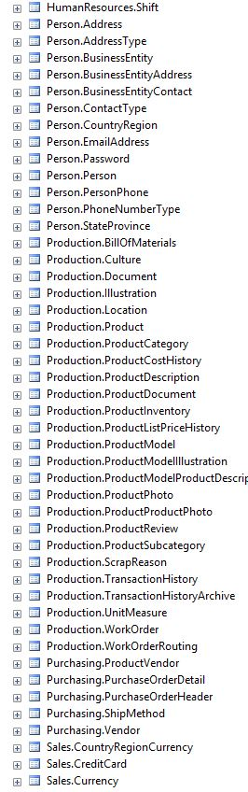
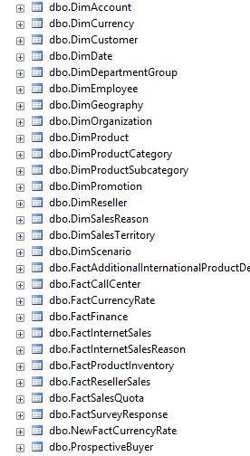
Do you remember?
AdventureWorks
AdventureWorksDW

Slide 5
Normal forms 1NF – 3NF

Slide 6
First Normal Form – 1NF
A table is in 1NF if the domain of each field contains only atomic values, and the value of each field contains only a single value from that domain.
Another way to state it:
Contains only atomic values
There are no repeating groups

Slide 7
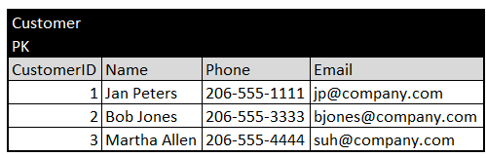
1NF Before

Slide 8
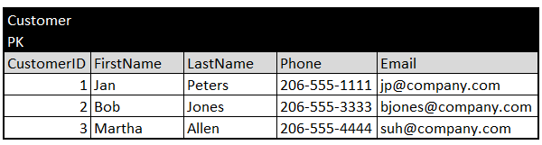
1NF After

Slide 9
More on the First Normal Form – 1NF
This type example, with repeating groups of fields, is often used an example of a violation of 1NF. Some experts argue it violates other normal forms, but no matter, it is bad design.
Before

Slide 10
More on the First Normal Form – 1NF
Here the repeating groups of fields have been eliminated.
After

Slide 11
Second Normal Form – 2NF
A table is in 2NF if and only if it is in 1NF and every non-key field is dependent on the whole of a candidate key.
Another way to state it:
It is in first normal form
All non-key attributes are fully dependent on the primary key

Slide 12
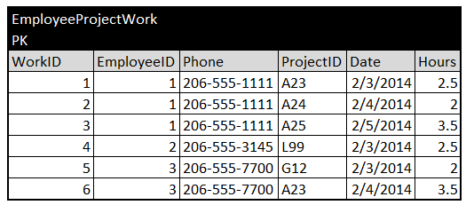
2NF Before

Slide 13
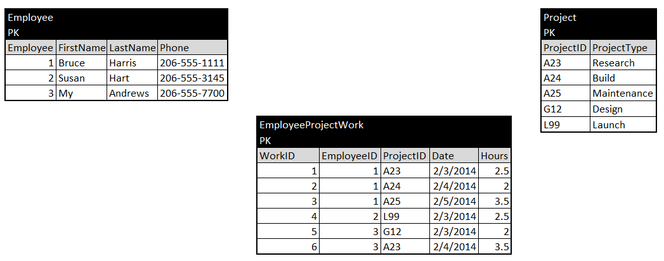
2NF After

Slide 14
Third Normal Form – 3NF
The table is in the third normal form if it is in the second normal form (2NF), and every non-key field must provide a fact about the key and only the key.

Slide 15
3NF Before

Slide 16
3NF After

Slide 17
To recap…
1NF – eliminate duplicates
2NF – non-key fields relate to the primary key
3NF – non-key fields don’t depend on other non-key fields

Slide 18
Normal forms BCNF, 4NF, 5NF, 6NF

Slide 19
Boyce-Codd Normal Form (BCNF)
BCNF is considered a stronger 3NF
Some call it 3.5NF

Slide 20
4NF, 5NF, 6NF
Normal forms beyond 3NF and BCNF are applied infrequently, though here are definitions below.
A table in 4NF cannot have more than one multivalued dependency. A multivalued dependency is where the primary key has a 1:M relationship to a non-key field.
To satisfy 5NF data structure is split into smaller and smaller tables until all redundancy has been eliminated.
6NF – also know as domain-key normal form (DKNF) – is a theoretical concept and not something that can be implemented in RDBMS. It enforces constraints at the conceptual relationship level, rather than at the table or field level. It says that every constraint on the relation is dependent only on key and domain constraints. A domain constraint dictates the values allowed in a field.

Slide 21
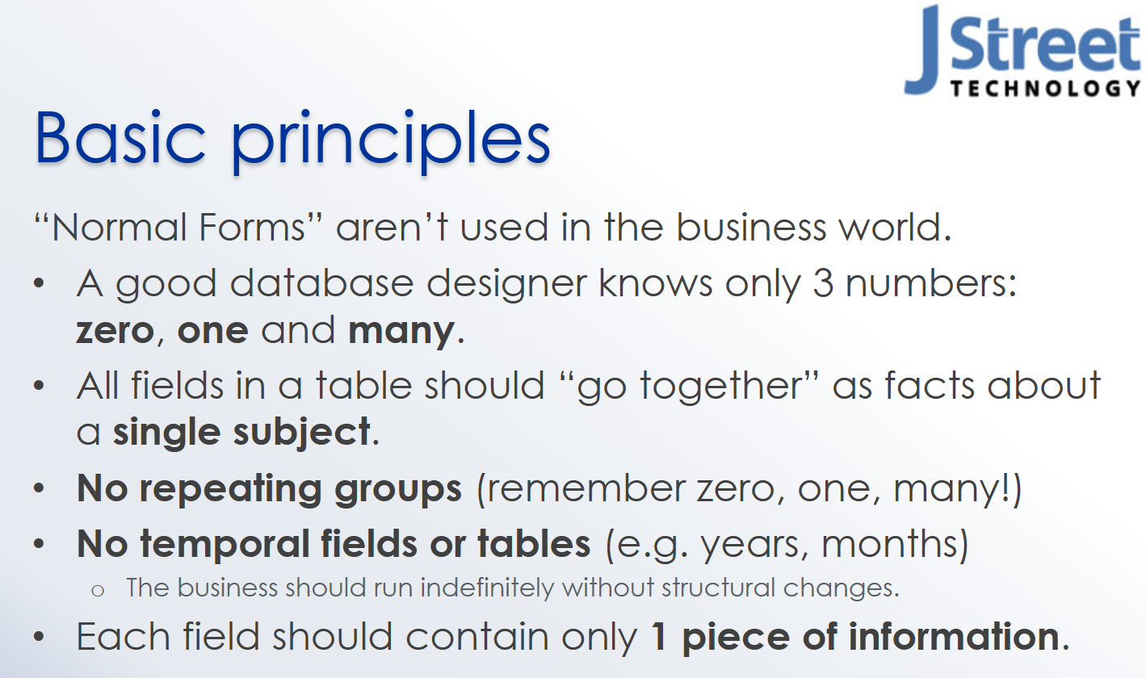
Is Normalization Really Necessary?

Slide 22
The End

